Slide 1


To ANCOVA or RM ANOVA? That is the question…
Keith Lohse, PhD
http://compare2what.blogspot.com/
motorlearnlab@gmail.com

Slide 2

How should I compare the effect of two treatments in a pre/post design?
Pre-test
Measure of Primary Outcome
Alas, simple answers. I knew them Horatio…
Random Assignment
Treatment
Control
Post-test
Second Measure of Primary Outcome
[telegraph.co.uk]

Slide 3
How should I compare the effect of two treatments in a pre/post design?
Depending on your training, your default choice might be an analysis of covariance (ANCOVA) or a mixed-factorial ANOVA with Time (pre/post-test) as a repeated measure.
However, both of these analyses are applications of the GLM model…
…and in this 2 x 2 sort of design, the ANCOVA is almost always going to be the superior choice.
But why? [See Van Breukelen, 2006; Vickers & Altman, 2001]

Slide 4
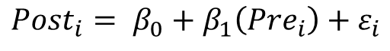
Understanding the GLM
Group {-1 = Control; +1 = Treatment}
ANCOVA Controlling for Pre-Test
Is Model 2 better at explaining our data than Model 1?
We want total error (sum of ε’s) to be a small as possible.
$${Post}_{i}= β_{0}+β_{1}\left({Pre}_{i}\right)+ε_{i}$$
$${Post}_{i}= β_{0}+β_{1}\left({Pre}_{i}\right)+β_{2}({Group}_{i})+ε_{i}$$
RM ANOVA (Group x Time Interaction)
The intercept is the “main effect” of Time.
(ie, Is the Post – Pre difference = 0 ?)
The slope is the “interaction” between Group and Time.
(ie, Do the groups change by different amounts?)
$${(Post}_{i}−{Pre}_{i})= β_{0}+β_{2}\left({Group}_{i}\right)+ε_{i}$$
$${(Post}_{i}−(1){Pre}_{i})= β_{0}+β_{2}\left({Group}_{i}\right)+ε_{i}$$

Slide 5
Understanding the GLM
How do we separate the effect of our treatment from noise?
(ie, How do we separate variation due to the treatment from variability between people?)

Slide 6
Understanding the GLM
How do we separate the effect of our treatment from noise?
(ie, How do we separate variation due to the treatment from variability between people?)
ANCOVA Controlling for Pre-Test
RM ANOVA (Group x Time Interaction)
$${Post}_{i}= β_{0}+β_{1}\left({Pre}_{i}\right)+β_{2}({Group}_{i})+ε_{i}$$
$${(Post}_{i}−(1){Pre}_{i})= β_{0}+β_{2}\left({Group}_{i}\right)+ε_{i}$$

Slide 7
Let’s compare the two methods…
I have written some simulations to create correlated Pre/Post-Test data for our two treatment groups (see R code in text).
In this first video: Three illustrative examples.
In the second video: A more detailed explanation of the simulations and the statistical power of each test.

Slide 8
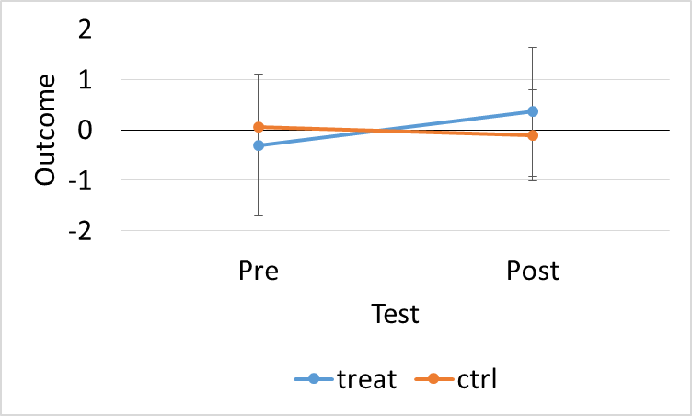

Example #1
In a 2 (Time) x 2 (Group) design, with n/group = 20…
The mean of the post test for control = -0.11 and for treatment = 0.36. This difference is not statistically significant (p=0.19).
[http://ifthesebookscouldtalk.com/wp-content/uploads/sites/ 55/2015/03/sorry.gif]

Slide 9
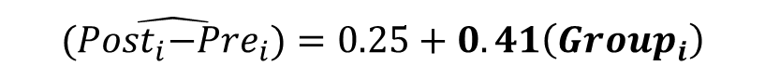
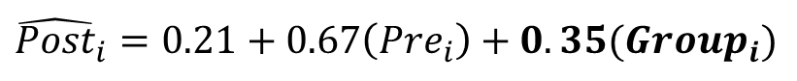
Example #1
ANCOVA Controlling for Pre-Test
RM ANOVA (Group x Time Interaction)
$${\hat{Post}}_{i}=0.21+0.67\left({Pre}_{i}\right)+0.35({Group}_{i})$$
$$\hat{{(Post}_{i}−{Pre}_{i})}=0.25+0.41\left({Group}_{i}\right)$$
Effect | Coefficient | P-Value
Intercept | 0.21 | 0.11
Pre-Test | 0.67 | 0.009*
Group | 0.35 | <0.001*
Effect | Coefficient | P-Value
Intercept (ME Time) | 0.25 | 0.078
Group (INT GxT) | 0.41 | 0.005*
True difference = 0.50; Estimated = 2*0.35 = 0.70
Estimated = 2*0.41 = 0.81
In this case, our analytical choices don’t make much of a difference, but note that:
The correlation between pre-test and post-test happened to be very strong (r = 0.64)
The treatment effect is larger with the RM ANOVA, because the difference scores do not account for regression to the mean.

Slide 10
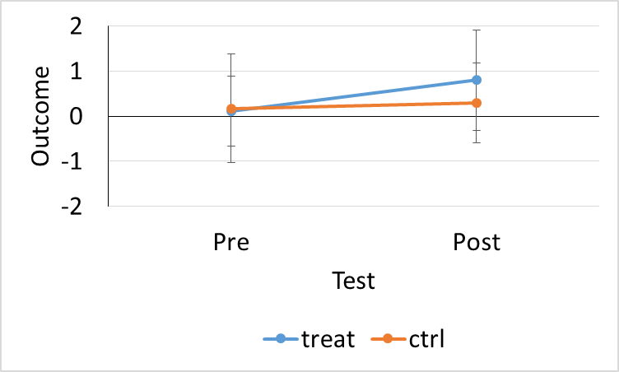

Example #2
In a 2 (Time) x 2 (Group) design, with n/group = 20…
The mean of the post test for control = 0.29 and for treatment = 0.79. This difference is not statistically significant (p=0.13).
[tumblr.com]

Slide 11
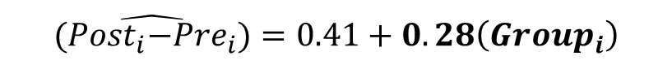
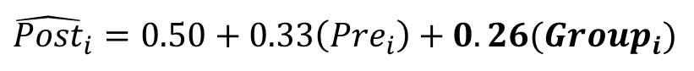
Example #2
ANCOVA Controlling for Pre-Test
RM ANOVA (Group x Time Interaction)
$${\hat{Post}}_{i}=0.50+0.33\left({Pre}_{i}\right)+0.26({Group}_{i})$$
$$\hat{{(Post}_{i}−{Pre}_{i})}=0.41+0.28\left({Group}_{i}\right)$$
Effect | Coefficient | P-Value
Intercept | 0.50 | 0.003*
Pre-Test | 0.33 | 0.037*
Group | 0.26 | 0.099.
Effect | Coefficient | P-Value
Intercept (ME Time) | 0.41 | 0.034*
Group (INT GxT) | 0.28 | 0.140
True difference = 0.50; Estimated = 2*0.26 = 0.52
Estimated = 2*0.28 = 0.56
Now our analytical choices start to matter a lot more:
The correlation between pre-test and post-test is only mildly positive (r = 0.31)
The treatment effect is larger with the RM ANOVA, because the difference scores do not account for regression to the mean.

Slide 12
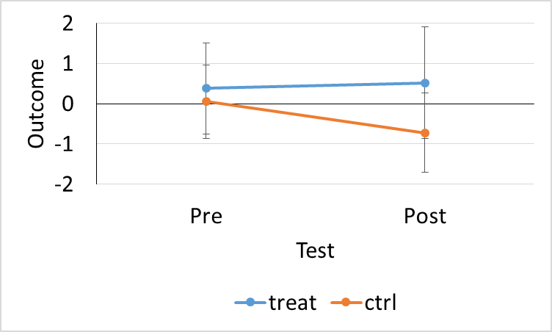
Example #3
In a 2 (Time) x 2 (Group) design, with n/group = 20…
The mean of the post test for control = -0.72 and for treatment = 0.52. This difference is statistically significant (p=0.02), but we are most interested in changes over time.

Slide 13
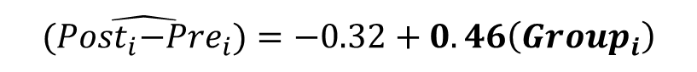
Example #3
ANCOVA Controlling for Pre-Test
RM ANOVA (Group x Time Interaction)
$${\hat{Post}}_{i}=−0.14+0.18\left({Pre}_{i}\right)+0.59({Group}_{i})$$
$$\hat{{(Post}_{i}−{Pre}_{i})}=−0.32+0.46\left({Group}_{i}\right)$$
Effect | Coefficient | P-Value
Intercept | -0.14 | 0.477*
Pre-Test | 0.18 | 0.344
Group | 0.59 | 0.004*
Effect | Coefficient | P-Value
Intercept (ME Time) | -0.32 | 0.179
Group (INT GxT) | 0.46 | 0.064
True difference = 0.50; Estimated = 2*0.59 = 1.18
Estimated = 2*0.41 = 0.92
Again, our analytical choices start to matter a lot more:
The correlation between pre-test and post-test is pretty weak (r = 0.12)
The Group x Time interaction is not statistically significant because the closer we get to r = 0, we are essentially adding noise to our outcome measure.

Slide 14

So, which is better?
ANCOVA
Removes between-subject variability for more accurate treatment effects.
Tries to account for regression to the mean.
Improves statistical power the stronger the correlation of the covariate and it will never hurt statistical power.
RM ANOVA
Removes between-subject variability for more accurate interaction effect.
Ignores regression to the mean (which can distort treatment effects).
Improves statistical power then time-points are correlated, but hurts power when they are not correlated (actually when r < 0.5).
Ie, taking the difference in poorly correlated factors is equivalent to adding noise.

Slide 15

Thanks for watching!
Thanks also to Brooks Mobley and Mike Roberts at Auburn University.
If you have any questions, you can email them to me at motorlearnlab@gmail.com or leave a comment below.

